Slide 1

WHAT TO EXPECT
FROM A
HEALTH PLAN INVESTIGATION
United States Department of Labor
Employee Benefits Security Administration
Notes:
Update January 2023

Slide 2
Disclaimer
This presentation may contain opinions of the presenter that may not comport with the official views of the U.S. Department of Labor and is meant for educational purposes only.

Slide 3
Outline of Presentation
Background on EBSA
ERISA and fiduciary responsibility
Types of investigations
Health Enforcement Initiatives Project
EBSA investigation process
Correction & Voluntary Fiduciary Compliance Program
Compliance assistance and other resources

Slide 4
General Organization Overview
The Employee Benefits Security Administration (EBSA)

Slide 5
The mission of the Employee Benefits Security Administration is to assure the security of the retirement, health and other workplace related benefits of America’s workers and their families. We will accomplish this mission by:
  developing effective regulations;
  assisting and educating workers, plan sponsors, fiduciaries and service providers; and
  vigorously enforcing the law.
EBSA’s Mission Statement

Slide 6
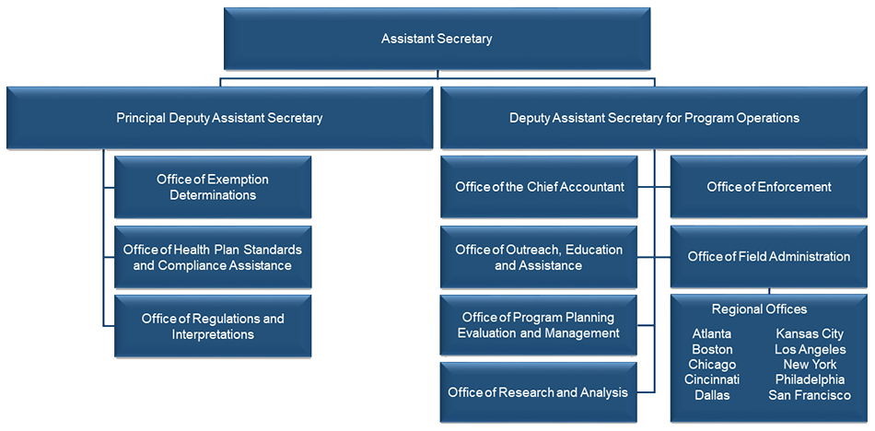
Organization Chart
Organization Chart

Slide 7
EBSA - Structure
NATIONAL OFFICE
Establishes policy and agency protocols
REGIONAL OFFICES
Conduct investigations of ERISA plans
Oversight of reporting and disclosure requirements
Drafts regulations and interpretive guidance
Conducts economic research to determine impact of policy and regulations on regulated community
Conducts outreach such as the Health Benefits Education Campaign
Provide compliance assistance through Benefit Advisors
Conduct outreach to plan sponsors and other stakeholders

Slide 8
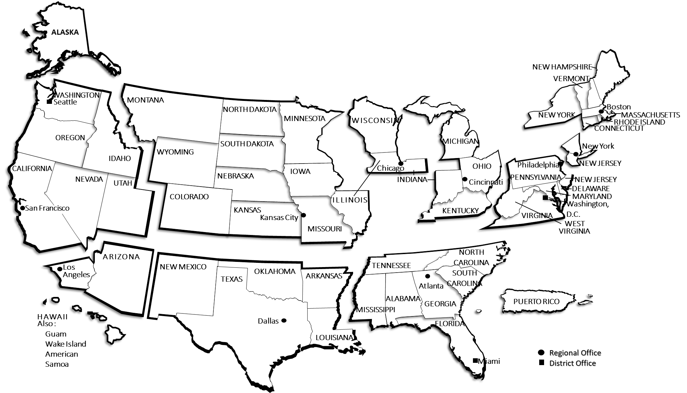
EBSA Field Offices

Slide 9
EBSA Enforcement Strategy
Department of Labor Strategic Plan 2024-2026
This outlines the strategies the Department uses to guide the agency mission
EBSA Strategic Enforcement Plan
Last published in 2000, the primary purpose is to establish a general framework through which EBSA's enforcement resources may be efficiently and effectively focused to achieve the agency's policy and operational objectives
National Enforcement Projects
Published annually and publicly available at https://www.dol.gov/agencies/ebsa/about-ebsa/our-activities/enforcement

Slide 10
ERISA Basics for Group Health Plans
ERISA Basics for Group Health Plans

Slide 11
Employee Retirement Income Security Act (ERISA)
Applies to employee benefit plans sponsored by private sector employers and/or unions
NOT government plans
NOT church plans
Other exclusions may apply
Generally, ERISA allows the plan sponsor to decide whether to offer a plan and allows flexibility in the plan’s benefit design.

Slide 12
A Few Basic Things a Group Health Plan Must Have
A Few Basic Things a Group Health Plan Must Have:
A named Fiduciary
Reasonable claims & appeals procedures
Fidelity bond (to protect against dishonesty) unless the plan is funded solely by general assets of plan sponsor
A Summary Plan Description (SPD) provided to participants and beneficiaries
Governing plan document(s) must comply with ERISA

Slide 13
Regulation of Group Health Plans
ERISA Regulation
Title I of ERISA applies to employee welfare benefit plans
ERISA Preemption
Internal Revenue Code
Public Health Service Act
Fair Labor Standards Act
Pregnancy Discrimination Act
Americans with Disabilities Act
Other Laws Include:
GROUP HEALTH PLAN

Slide 14
Health Laws Included in ERISA Part 7
Patient Protection and Affordable Care Act (Affordable Care Act)
Genetic Information Nondiscrimination Act (GINA)
Children’s Health Insurance Program Reauthorization Act (CHIPRA)
Women’s Health and Cancer Rights Act (WHCRA)
Mental Health Parity and Addiction Equity Act (MHPAEA)
Newborns’ and Mothers’ Health Protection Act (Newborns’ Act)
Consolidated Omnibus Budget Reconciliation Act (COBRA)
Health Insurance Portability and Accountability Act (HIPAA)
No Surprises Act (NSA)

Slide 15
Enforcement and Jurisdiction
Department of Labor
ERISA
Department of Health and Human Services
Department of Treasury
Internal Revenue Code
States
Public Health Service Act
State Insurance Laws
Participants and Beneficiaries
Private litigation

Slide 16
Enforcement and Jurisdiction
Department of Labor’s Enforcement Role
  DOL is responsible for enforcing the requirements of Title I of ERISA with respect to employment-based group health plans

Slide 17
Enforcement and Jurisdiction
Role of the States
  States have direct jurisdiction over health insurance issuers that sell products in their state.
  Group health plans frequently purchase health insurance products from licensed health insurance issuers. Generally, these products are reviewed for compliance by the state insurance department; however, not all issuer’s products undergo market conduct exams.

Slide 18
Department of Health and Human Service’s Role
  Generally, the states enforce state laws that place requirements on issuers. These provisions of these state laws must be at least as protective as ERISA part 7 and the Public Health Service Act (PHSA).
  However, if Health and Human Services determines that a state has failed to “substantially enforce” its parallel laws, HHS can directly enforce the PHSA with respect to health issuers in that state.
  HHS may also be invited in by the state to enforce in that state
Enforcement and Jurisdiction

Slide 19
Enforcement and Jurisdiction
Department of Treasury’s Enforcement Role
  Treasury enforces most of the requirements of the ERISA health laws through parallel Internal Revenue Code provisions.
  Treasury may impose an excise tax on plans or employers that fail to comply with these health laws

Slide 20
Enforcement and Jurisdiction
Participants and Beneficiaries
  ERISA Section 502(a) states the following: Participants and beneficiaries also have a private right of action to enforce their rights against plans and issuers

Slide 21
ERISA Reporting and Disclosure for Group Health Plans
Reporting Requirements
Certain group health plans must file the Annual Report (Form 5500) with the DOL Secretary
Disclosure Requirements include:
Summary Plan Description (SPD)
Summary of material modifications (SMM)
Summary of Benefits and Coverage (SBC)
COBRA notices
Adverse Benefit Determinations and other disclosures as required by ERISA 503 claims procedure rules
Various notices to comply with the health laws of ERISA part 7
Multiple Employer Welfare Arrangements (MEWAs) must file the Form M-1.

Slide 22
COBRA Premium Assistance under the American Rescue Plan(ARP)
On September 30, 2021, the COBRA premium subsidy ended. However, there are a number of health coverage options to consider.
    Continuing COBRA
    The Health Insurance Marketplace
    Other Group Health Plan Coverage
    Individual Health Insurance
    Government Programs
  This information can be found on the Department’s Website: https://www.dol.gov/cobra-subsidy

Slide 23
A Fiduciary is any person named as a plan fiduciary in plan documents – or who:
Exercises discretionary authority or control over plan management - or -
Exercises authority or control over plan assets - or -
Provides investment advice for compensation (direct or indirect)
What is a Fiduciary?

Slide 24
Plans can have multiple fiduciaries
Fiduciaries can be named or functional
Plan Fiduciaries
Plan
Fiduciary B remits premiums
Fiduciary C makes claim determinations
Fiduciary A selects service providers

Slide 25
Act “solely in the interest” of participants & beneficiaries
Discharge duties prudently with care, skill and diligence
Diversify plan investments
Follow terms of governing documents (to the extent they are consistent with ERISA)
Follow governing provisions of ERISA under Part 7.
A Fiduciary must:

Slide 26
Act in the fiduciary’s own self interest
Act on behalf of a party with adverse interests
Accept “anything of value” from those doing business w/ the Plan (e.g. kickbacks)
A Fiduciary must NOT:

Slide 27
* Note that if a Plan/fiduciary/party in interest satisfies the requirements of a prohibited transaction exemption, the above transactions could be permissible
Fiduciaries must NOT cause the Plan to engage in a prohibited transaction such as:
Sale or exchange of plan assets with a party in interest (PII)
Extension of loan or credit to a party in interest
Contract for goods, services or facilities with a party in interest
Transfer plan assets to a party in interest for their use or benefit

Slide 28
Parties in Interest
Party in interest (PII)
Relatives of fiduciaries
Related companies
Fiduciaries
Officers, employees & owners
Sponsoring employer or union
Service providers
Officers, employees & owners

Slide 29
Fiduciaries
Fiduciaries can be held personally liable for losses resulting from a fiduciary breach
if A’s failure(s) allowed B to breach
if A knowingly participated in or knowingly concealed B’s breach
if A knows about B’s breach and fails to make reasonable efforts to correct B’s breach
For example: Fiduciary A can also be held personally liable for losses resulting from a breach by Fiduciary B

Slide 30
ERISA Sec. 502(l) imposes a 20% penalty on the amount paid pursuant to a court order or settlement agreement.
The IRS can impose excise tax on prohibited transactions.
The IRS can impose excise tax under IRC Sec. 4980D for failure to meet certain group health plan requirements
Numerous other penalties for Reporting and Disclosure failures
Penalties may be imposed for a breach of fiduciary duty

Slide 31
Examples include:
Accepting kickbacks
Filing fraudulent claims
Stealing premiums or contributions
Some fiduciary breaches may also constitute criminal violations of ERISA, other federal law, or state law.

Slide 32
Types of investigations

Slide 33
An Individual
Investigations may be civil or criminal in nature and may focus on:
The Plan Sponsor
The Plan
A Service provider

Slide 34
Sources for Targeted Investigations
Sources for Targeted Investigations
Participant complaints
Form 5500/Form M-1 Reviews
Referrals from:
Other agencies
State insurance departments
Advocacy groups
Media
Private litigation

Slide 35
National Health Enforcement Initiatives Project

Slide 36
The national initiatives for health enforcement for Fiscal Year 2024 remain unchanged from Fiscal Year 2023 and include Multiple Employer Welfare Arrangement (MEWA) financial solvency/fraud investigations, emergency services, and health service provider self-dealing. MHPAEA enforcement is now a national project and there will be a continued increased focus on MHPAEA in Fiscal Year 2024. Enforcement of the group health plan requirements related to COVID-19 and COBRA under the Families First Coronavirus Response Act (FFCRA) and the Coronavirus Aid, Relief, and Economic Security (CARES) Act, and the American Rescue Plan will also be areas of focus in Fiscal Year 2024, as will implementation and enforcement of the surprise billing and transparency provisions of the Consolidated Appropriations Act of 2020. The Equity Enforcement Focus will also continue from Fiscal Year 2023, which focuses on the enforcement program’s impact on equity issues and having a positive impact on underserved communities.
The national initiatives include a broad range of investigative issues such as:
Proper plan administration
Proper claims payment
Service provider fees
Compliance with claims procedure rules
Compliance with health care laws under Part 7 of ERISA in stated plan terms and operations
Insolvency/unpaid claims
Health Enforcement Initiatives

Slide 37
Failure to provide benefits in accordance with plan terms
Improper or arbitrary claims adjudication
Failure to follow the DOL’s claims procedure rules
Failure to forward employee premiums to the insurance provider
Failure to provide mental health benefits in parity with medical/surgical benefits in accordance with mental health parity rules
Failure to provide required notices
Examples of Group Health Plan Violations

Slide 38
Investigative Process

Slide 39
General Process for Civil Plan Investigations
CASE OPENING LETTER
REQUEST DOCUMENTS
CORRECTION
CLOSING LETTER
INTERVIEWS
VOLUNTARY COMPLIANCE LETTER

Slide 40
Initial Investigative Steps
Determine basic operations of the health plan
Is the plan fully-insured or self-insured?
Determine all service providers
Review contributions/premiums
Review claims process and benefit payments
Determine compliance with Part 7 of ERISA
Document review
Arrange for access to any additional documents required
Arrange for additional interviews
Ensure all requested documents have been made available

Slide 41
Plan document/ Summary Plan Description (SPD)/ Certificate of Coverage
Summary of Benefits and Coverage (SBC)
Service provider contracts
Premium or contribution schedules
Documents related to plan finances
Claims data and claims files
Claims Adjudication Policies and Guidelines
Participant notices required by ERISA
Other documents related to ERISA compliance
Basic Health Plan Documents

Slide 42
ERISA grants the DOL (EBSA) the power to “enter such places, inspect such books and records and question such persons … as deemed necessary”
The DOL (EBSA) has the authority to issue subpoenas requiring the production of documents or testimony
Subpoenas

Slide 43
Speak with plan sponsors and service providers to clarify plan terms to determine if violations of the health laws or other systemic problems exist.
Determine the extent and impact of harm to participants and beneficiaries due to violations.
Determine the most appropriate action to take to correct the problem.
Work with the service provider (if applicable) to make global corrections for all affected plan clients.
Findings and Follow-Up

Slide 44
Identifies problems & corrective actions taken
Indicates the case is closed
Voluntary Compliance Letter
Identifies violations
Offers a chance to discuss corrective action
If corrective action is not taken, those violations could potentially be referred to the DOL’s Solicitor’s Office.
Closing Letter

Slide 45
Correction & Voluntary Fiduciary Compliance Program

Slide 46
It is a “Self-help” program.
Correction methods are specified in regulations.
Participants submit completed applications to an EBSA Regional Office.
EBSA issues a “No Action” letter.
Some transactions are eligible for excise tax relief.
Voluntary Fiduciary Correction Program (VFCP)

Slide 47
EBSA encourages self-correction.
Fiduciaries should regularly review operations.
Use the Health Law Self-Compliance Tool
Upon detection, take corrective action.
Correction guidance is in VFCP documentation.
Call EBSA for compliance assistance
Corrections Pre-Investigation

Slide 48
Often, potential problems become clear during the investigation.
If a problem is identified, work with EBSA to make corrections.
Correction guidance may be available.
Proof of correction and number of participants and plans affected is required.
Correction During Investigation

Slide 49
A settlement agreement
Notification to Participants and Beneficiaries of the correction
Implementation of new internal controls
Re-adjudication of claims
Paying unpaid claims
Payment of Plan’s administrative costs and expenses
Interest
Disgorgement of profits or surcharge
Penalties
Removal of Fiduciaries
Removal of service providers
Appointing an Independent Fiduciary
Depending on the circumstances, appropriate corrective action may include:

Slide 50
Includes theft or embezzlement
Health care fraud
Kickbacks or bribes
False statements made to investigators
Willful failures to file or falsified filings
Criminal Referrals

Slide 51
Compliance Resources

Slide 52
EBSA website (health plans): https://www.dol.gov/agencies/ebsa/employers-and-advisers/plan-administration-and-compliance/health-plans
Health Benefits Laws Self Compliance Tools: https://www.dol.gov/agencies/ebsa/employers-and-advisers/plan-administration-and-compliance/health-plans/hbec/checksheets
Health and Human Services www.hhs.gov/healthcare
Health Plan Compliance Resources

Slide 53
EBSA main site: www.dol.gov/agencies/ebsa
EBSA Affordable Care Act page: www.dol.gov/agencies/ebsa/laws-and-regulations/laws/affordable-care-act/for-employers-and-advisers
EFAST2 website: www.efast.dol.gov
Technical Assistance and Publications:
askebsa.dol.gov or 1-866-444-3272
EFAST2 Hotline (Toll-free):
1-866-GO EFAST (1-866-463-3278)
Form M-1 Filings:
http://www.askebsa.dol.gov/mewa/ or call the
Form M-1 Help Desk at 202-693-8360
Compliance Assistance

Slide 54
Office of Health Plan Standards & Compliance Assistance
(202) 693-8335
Office of the Chief Accountant
(202) 693-8360
Office of Regulations & Interpretations
(202) 693-8500
Office of Exemption Determinations
(202) 693-8540
Compliance Assistance

Slide 55
Health Benefit Education Campaign two-day seminars
Webcasts
Regional workshops
Publications
Understanding Your Fiduciary Responsibilities under a Group Health Plan
Reporting and Disclosure Guide for Employee Benefit Plans
An Employer’s Guide to Health Benefits under COBRA
Health Benefits Coverage Under Federal Law
Outreach Events

Slide 56
Compliance Assistance on Mental Health Parity
U.S. DEPARTMENT OF LABOR
EMPLOYEE BENEFITS SECURITY ADMINISTRATION

Slide 57

Mental Health Parity – Background
A response to inconsistency in insurance coverage
Health insurance coverage for mental health and substance use disorder benefits should be offered on par with covered medical and surgical benefits

Slide 58

Mental Health Parity – Background
Two major mental health parity laws at the federal level are:
  Mental Health Parity Act of 1996 (MHPA)
  Paul Wellstone and Pete Domenici Mental Health Parity and Addiction Equity Act of 2008 (MHPAEA)

Slide 59
Mental Health Parity – Background
Mental health parity law protections have recently been expanded.
The DOL is currently working on rules and guidance to implement these changes.
This presentation covers only released guidance

Slide 60

Mental Health Parity – Background
MHPAEA requires group health plans to provide mental health and substance use disorder benefits at parity with (comparably to) medical and surgical benefits
Mental Health/ Substance Use Disorder
Medical/ Surgical

Slide 61

Who is Subject to Mental Health Parity?
Employer-sponsored health plans and health insurance issuers offering health insurance coverage for medical/ surgical benefits AND mental health/substance use disorder benefits
Private employer plans with 51+ workers
Most smaller employer plans
Health insurance coverage sold to individuals (i.e. Marketplace plans)

Slide 62

Must A Business Offer These Benefits?
Federal mental health parity does not require group health plans
or issuers to provide mental health/substance use disorder
benefits, but does require that when such benefits
are offered, they must be offered in parity.

Slide 63
What Protections Does Mental Health Parity Provide?
All financial restrictions and treatment limitations applicable to MH/SUD benefits must be comparable to the requirements or limitations applied to medical/surgical benefits
Financial requirements and Treatment limitations - copays, deductibles, - visit/day limits, coinsurance, out-of- duration of treatment, pocket max preauthorization reqs

Slide 64


General Mental Health Parity Requirements
Prohibited:
    Lifetime and annual dollar limits on MH/SUD benefits that are lower than those limits imposed on medical/surgical benefits*
    Cumulative financial requirements or cumulative quantitative treatment limitations for MH/SUD benefits that accumulate separately from medical/surgical benefits in the same classification
Required
    Disclosures on criteria for medical necessity and reasons for denial

Slide 65




Classification of Benefits
Plans must classify mental health and substance use disorder benefits within six classifications:
  Inpatient, in-network
  Inpatient, out-of-network
  Outpatient, in-network
  Outpatient, out-of-network
  Emergency care
  Prescription drugs

Slide 66
Financial Requirements and
Quantitative Treatment Limitations
If a plan provides MH/SUD benefits in any classification, MH/SUD benefits must be provided in every classification in which medical/surgical benefits are provided.
A plan may not impose a requirement or limitation to MH/SUD benefits that is more restrictive than the predominant financial requirement or treatment limitation of that type that is applied to substantially all medical/surgical benefits in the same classification.

Slide 67
Financial Requirements and
Quantitative Treatment Limitations - Example
  Example: Josh is insured by X Health Plan:
    Psychiatrist (Outpatient, in-network Mental Health) Copay: $75
    Primary Care (Outpatient, in-network Physical Health) Copay: $20
  Impermissible – the financial requirement applicable to MH/SUD benefits are not comparable to the financial requirement applied to medical/surgical benefits in the outpatient, in-network classification.

Slide 68
Financial Requirements and
Quantitative Treatment Limitations - Summary
General Rule Analysis – Need to identify the…
Classification (outpatient, in-network, etc)
Type of financial requirement or quantitative treatment limitation
Predominant level of copay applied to substantially all medical/surgical benefits within the classification
RESULT – This is the most restrictive copay that can be applied to MH/SUD benefits

Slide 69


Financial Requirements and Quantitative Treatment Limitations
Special Rules
Multi-Tiered Prescription Drug Benefits
Multiple Network Tiers
Sub-classification for office visits, separate from other outpatient services

Slide 70

Nonquantitative Treatment Limitations (NQTLs)
Non-quantitative treatment limitations also require parity
General rule:
  A plan may not impose NQTLs on MH/SUD benefits in any classification unless any processes, strategies, evidentiary standards, or other factors used in applying that NQTL are comparable to and are applied no more stringently than other factors that are used in applying that NQTL to Med/Surg benefits in the classification.

Slide 71

Nonquantitative Treatment Limitations (NQTLs)
An NQTL is a limitation on the scope or duration of benefits for treatment
  Such as medical necessity determinations, or fail-first policies
Generally not expressed numerically
A plan may not impose an NQTL that is a separate treatment limitation applicable only to MH/SUD benefits

Slide 72
Nonquantitative Treatment Limitations (NQTLs) - Examples
EXAMPLE - Medical management standards that limit benefits based on medical necessity or medical appropriateness, or based on whether the treatment is experimental or investigative
EXAMPLE - Preauthorization or concurrent review standards
EXAMPLE - Standards for provider admission to participate in a network, including reimbursement rates

Slide 73
Nonquantitative Treatment Limitations (NQTLs) – Examples continued
EXAMPLE - Plan methods for determining usual, customary and reasonable charges
EXAMPLE - Refusal to pay for higher-cost therapies until it can be shown that a lower-cost therapy is not effective (i.e. step-therapy or fail-first policies)
EXAMPLE - Restrictions based on geographic location, facility type and provider specialty, etc that limit the scope or duration of benefits for services

Slide 74

NQTL Warning Signs
Blanket preauthorization requirements
  Preauthorization is required for all MH/SUD services.
Treatment facility admission preauthorization
  If admitted to a mental health or substance abuse facility for non-emergency treatment without prior authorization, the insured will be responsible for 100% of the cost of services received.
Prescription Drug Preauthorization
  Preauthorization is required every three months for pain medications prescribed in connection with MH/SUD conditions.

Slide 75
NQTL Warning Signs
Treatment Attempt Requirements –
  For any inpatient MH/SUD services, the plan/insurer requires that an individual first complete a partial hospitalization treatment program.
Likelihood of Improvement –
  For residential treatment of MH/SUD, the plan/insurer requires the likelihood that inpatient treatment will result in improvement.
Treatment Plan Submission on a Regular Basis –
  Plan/insurer requires that an individual-specific treatment plan will be updated and submitted, in general, every 6 months

Slide 76

NQTLs – Questions to Ask
Questions you might ask while conducting an NQTL analysis:
Does the application of the NQTL include similar requirements for medical/surgical and MH/SUD in writing and in operation?
Is the reasoning for applying the NQTL to MH/SUD benefits supported by evidence, and is the evidence being used in a comparable way?
Is the process used in applying the NQTL similar or comparable?

Slide 77

NQTLs – Questions to Ask
Are differences arbitrary?
Are differences in the application of the NQTL to MH/SUD benefits consistent with practice guidelines?
Is it harder to “pass” the NQTL for MH/SUD than it is for medical/surgical?
Are the consequences more severe for failing to meet the NQTL requirements as they apply to MH/SUD benefits?

Slide 78

Increased Enforcement under the Consolidated Appropriations Act
The Consolidated Appropriations Act, 2021 (the Appropriations Act) added new enforcement tools to ensure compliance.
It requires group health plans and issuers to perform and document their parity comparative analysis with respect to design and application of NQTLs.
Plans and issuers must make the comparative analyses available to participants and beneficiaries on request.

Slide 79
Increased Enforcement under the Consolidated Appropriations Act
Plans and issuers must make available the comparative analyses with respect to each plan or coverage:
  Parity comparative analyses – that the processes, strategies, evidentiary standards, and other factors used to apply the NQTLs to MH/SUD benefits are comparable to and no more stringently applied than those for medical/surgical benefits, as written and in operation; and
  Specific findings and conclusions – including any results of the analyses that indicate that the plan or coverage is or is not in compliance with mental health parity.

Slide 80
Increased Enforcement under the Consolidated Appropriations Act
Also requires the Departments of Labor, Health and Human Services, and the Department of Treasury (the Departments) to request review of at least 20 of these analyses and to report to Congress on their conclusions.
First report issued was on January 25, 2022: https://www.dol.gov/sites/dolgov/files/EBSA/laws-and-regulations/laws/mental-health-parity/report-to-congress-2022-realizing-parity-reducing-stigma-and-raising-awareness.pdf
Common issues:
  Many plans and issuers were unprepared to respond to the Departments’ requests and had not started preparing their comparative analyses by the deadline.
  Many plans submitted comparative analyses that lacked sufficient detail to determine compliance.
  Other plans produced analyses that did not address the specific NQTL flagged in the request, were outdated, or were prepared by a service provider to address an entirely different line of business or insurance product.

Slide 81
Increased Enforcement under the Consolidated Appropriations Act
What happens if initial finding of noncompliance occurs-
  The plan or issuer takes corrective actions and provides the Departments additional comparative analyses within 45 days of notice of noncompliance.
What happens if a final determination of noncompliance occurs-
  The plan or issuer notifies all covered individuals within 7 days of notice of noncompliance.
  The Departments share findings with the State and notify Congress in a publicly-available annual report.

Slide 82
Guidance on the Appropriations Act – Mental Health Parity Requirements
Frequently Asked Questions (FAQs Part 45)
  Explains plans’ and issuers’ responsibilities under the Consolidated Appropriations Act and intended enforcement
Special focus on the following NQTLs:
  Prior authorization requirements
  Concurrent review requirements
  Standards for provider admission to participate in a network (including reimbursement rates)
  Out-of-network reimbursement rates
  Other NQTLs identified in written provisions or plan/issuer practices

Slide 83
Guidance on the Appropriations Act –Mental Health Parity Requirements
Comparative Analysis - NQTL Element | Example of Insufficient NQTL Comparative Analysis
This identifies factors, evidentiary standards or sources, or strategies or processes considered in the design or application of the NQTL, and in determining which MH/SUD benefits and medical/surgical benefits are subject to the NQTL. | This includes production of large volume of documents without a clear explanation of their relevance to the comparative analysis.

Slide 84
Guidance on the Appropriations Act –Mental Health Parity Requirements
Comparative Analysis - NQTL Element | Example of Insufficient NQTL Comparative Analysis
Analyses should explain if there are any variation in the application of a guideline or standard used by the plan or issuer between MH/SUD and medical/surgical benefits | Identification of processes, strategies, sources, and factors without clear and detailed analysis or explanation of how they were defined and applied

Slide 85
Guidance on the Appropriations Act –Mental Health Parity Requirements
Comparative Analysis - NQTL Element | Example of Insufficient NQTL Comparative Analysis
Includes discussion of the findings/conclusions as to the comparability of the processes, strategies, evidentiary standards, factors, and sources within each affected classification, and their relative stringency, both as written and as applied. | Reference to factors and evidentiary standards that were defined or applied in a quantitative manner, without the precise definitions, data, and information necessary to assess their development or application

Slide 86
Guidance on the Appropriations Act –Mental Health Parity Requirements
The plan or issuer should have available documentation on:
  NQTL processes and application to ensure it can demonstrate compliance with the law
  Anything it has relied on to determine that the NQTLs apply no more stringently to MH/SUD benefits
  Samples of covered and denied MH/SUD and medical/surgical benefit claims
  Documents related to parity compliance with respect to service providers
Participants and beneficiaries can also request the comparative analyses and other applicable information from their plan.

Slide 87

Mental Health Self-Compliance Tool on the DOL EBSA Web site
Who is it for?
  Group health plan sponsors and administrators, health insurance issuers, State regulators, and other stakeholders
What does it do?
  Helps determine whether a group health plan or health insurance issuer complies with the mental health parity laws
Updated every two years

Slide 88

Best Practices for Establishing an
Internal Compliance Plan
Conducting Effective Training and Education
  Includes individuals making decisions on behalf of the plan or issuer
Ensuring retention of records and information
  Requirements under ERISA Section 107 (i.e. retention period, types of records, etc.)
  Comparative analyses that involve potential mental health parity violations or complaints

Slide 89
Best Practices for Establishing an
Internal Compliance Plan Continued
Conducting internal monitoring and regular compliance reviews
  Auditing samples of adverse benefit determinations
  Clear protocols in delegating management of benefits to another entity
Responding promptly to detected offenses and developing corrective action plans
  Includes retroactive relief and notice to potentially affected participants

Slide 90
U.S. Department of Labor
Mental Health Parity Resources
For more information about the federal mental health and substance use disorder law:
  EBSA’s dedicated Mental Health Parity page - https://www.dol.gov/agencies/ebsa/laws-and-regulations/laws/mental-health-and-substance-use-disorder-parity
  Your state’s department of insurance website and contact information, which can be found on the National Association of Insurance Commissioners website – https://content.naic.org/cmte_b_mhpaea_wg.htm
  The Substance Abuse and Mental Health Services Administration (SAMHSA) Implementation of the Mental Health Parity and Addiction Equity Act (MHPAEA) website: www.samhsa.gov
  For more specific questions you can also contact a benefits advisor by visiting askebsa.dol.gov or calling 1-866-444-3272

Slide 91

Questions?

